Slide 1
Use Case: Translating Natural Language questions from users and return data from Snowflake
Overview:
Organizations are struggling to provide their users with an easily accessible data
Despite of having a transformed data, some users struggle to take advantage of technical tools to get meaningful insights out of available data
Using an AI-based approach allows users to ask a simple question using natural language and get desired result/insight almost instantly
In this use case, we shall explore how to create a Streamlit application that allows business users to input a question and query their Snowflake Data Cloud tables to get an answer
Solution Overview:
AI has the potential to provide business users with quick insights into their company data, making it a big opportunity.
Step 1: Creating a Streamlit application that allows users to ask a question.
Step 2: User question is fed to ChatGPT and AI Search.
Step 3: ChatGPT generates a SQL query that gets executed in the Snowflake Data Cloud
Step 4: The results are returned to application in a table format and then to the user

Slide 2

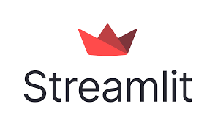

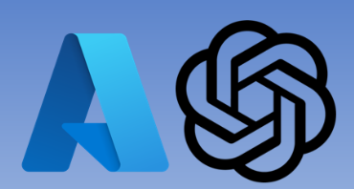
Proposed Architecture
Result
Data
Question
Query
Application
User
Snowflake
Prompt + Knowledge
Response
Azure Open AI

